Slide 1
The Swedish eHealth Agency
16 January 2023

Slide 2

About the Swedish eHealth Agency
Established on 1st of January 2014
Under the responsibility of the Swedish Ministry of Health and Social Affairs
Director General: Gunilla Nordlöf
Assignments from the
national government

Slide 3

The Swedish eHealth Agency
National Contact Point for eHealth (NCPeH)
Responsible for the coordination of the Swedish Government’s initiatives in eHealth
Responsible for managing all registries necessary for exchanging e-prescription information
Responsible for issuing the EU Covid certificate
Located in Kalmar and Stockholm

Slide 4
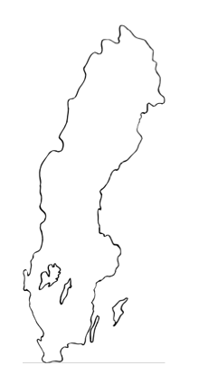
Governance of Sweden – Healthcare and Welfare in Sweden
National level
Elections to the Swedish parliament
Central government agencies
Regulations
Regional level
21 regions
Elections to the County Council assembly
Responsible for organising, financing and providing health care services
Local level
290 municipalities
Elections to the Municipal Council
Responsible for social services, care of the elderly and disabled
Pharmacies
Each level is autonomous with taxation rights and elected every 4 years

Slide 5
E-prescriptions
Health care
Pharmacies
Prescribers
Individuals
Pharmacists
Care provider systems
Apps, webbs
Pharmacy systems
Receptmodul i journalsystem
Receptexpeditions-system
Receptexpeditions-system
Receptmodul i journalsystem
Receptexpeditions-system
Receptexpeditions-system
Swedish eHealth Agency
E-prescriptions, Sales transcations etc

Slide 6

E-prescriptions for animals
National prescription register for prescriptions for animals
Many advantages for pet owners, veterinarians and pharmacies
Increasing use
More than 90% e-prescriptions in 2021

Slide 7

Support for customer connection
Our registers contain sensitive personal data. We are responsible for ensuring that external systems connect securely and offer:
  customer support and guidance
  validation and approval of healthcare- and pharmacy systems that exchange information in the flow of ePrescriptions

Slide 8



National medication list - Shared information
The national medication list provides detailed information about current and previously prescribed medicines.
All pharmacies report to the eHealth Agency information on dispensed prescriptions.
This information is used, among other things, to share information.
Patients have access to the same information as the care providers, healthcare staff and pharmacists. Patients can block access to certain information.
Pharmacist can see the same information as the patient and healthcare staff, and with the patients concent, prescription cause.

Slide 9

National Drug Statistics
The Swedish eHealth Agency are responsible for Sweden’s national drug statistics
We compile, process and publish statistics on pharmaceutical sales in Sweden
The Swedish drug statistics are unique as we have a long history of statistics (through previous government ownership)

Slide 10
Vision for eHealth 2025

Slide 11
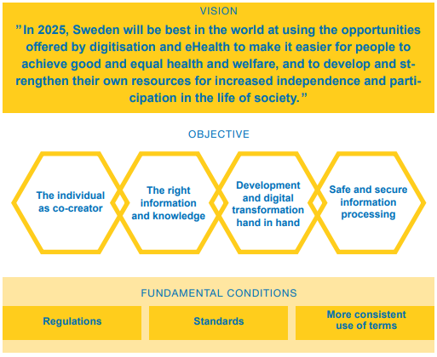
Vision for eHealth 2025

Slide 12
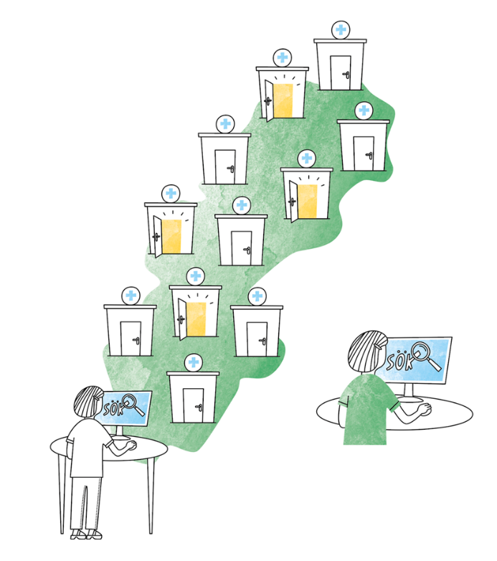
National care search system
Goverment assignment S2022/01372
2023-01-16

Slide 13

Background
The Swedish health system performs well in general, life expectancy in the country is high
and the general health among the population
is good.
One of our largest problems is that
it can be long waiting times before
a patient is granted an appointment with a
specialist.

Slide 14
Problems to solve
long waiting queues due to a shortage of nurses and available doctors in some areas
waiting times vary dramatically across Sweden's 21 counties responsible for financing hospitals.
Notes:
The Swedish health system performs well in general, life expectancy in the country is high and the general health among the population is good.

Slide 15

Our assignment
The Swedish eHealth Agency has got the task to propose a tool that makes it easier for health professionals in primary care to find available timeslots in specialist care for further treatment of the patient.

Slide 16
Cooperation
National Board of Health and Welfare (Socialstyrelsen)
Health and Social Care Inspectorate (IVO)
Agency for Digital Government (DIGG)
If necessary also with other relevant authorities, SKR (Sweden's municipalities and regions), Regions, Vårdföretagarna, Inera AB, relevant professional associations and other stakeholders

Slide 17

Schedule
Ongoing information to the ministry
Partial accounting 2023-01-13
Final report 2023-08-31

Slide 18
Presentation of Estonian national booking system

Slide 19
Areas of interest
What information elements is presented to the patient enabling him/her to find relevant care provider and book time?
Do you have all needed data stored centrally or distributed att HCPO ?
How do you separate between public financed care and privat financed care ?
How is the process when primary care refers to specialist care ? Will HCP in primary care also use the system?

Slide 20
Our solution proposal

Slide 21

The care search system must show:
  vacant and available care capacity
  - throughout the country
  - in real time for the regions
  information on agreements with
  public and private care providers,
  in their own region and within other regions

Slide 22
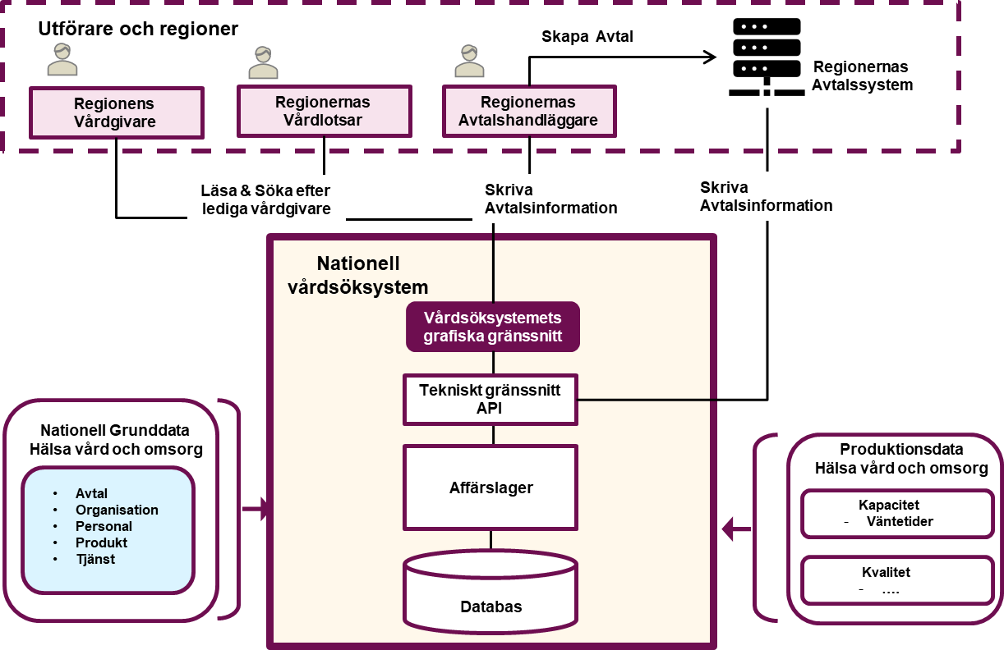
Our solution
The following information is assumed to be needed nationally.
Contract details:
Information of the agreement signed btw HCPO and Region
HCPO contact details.
HCPO healthcare services available.
Production data:
Information about healthcare provider current waiting times.
Quality parameters

Slide 23
Q&A

Slide 24
Further cooperation between TEHIK and Swedish eHealth agency

Slide 25
Thank you

