Slide 1
TEHIK
Health and Welfare Information Systems Center
Tõnis Jaagus / Head of Health Division
16.01.2022

Slide 2


Health and Welfare Information Systems Center
HWISC is an ICT competence center founded on 1st of January 2017 which consolidates the roles and responsibilities of former ICT department of Ministry of Social Affairs and Estonian eHealth Foundation
HWISC takes care of public sector ICT solutions in 3 domains:
Health
Labour
Social Security

Slide 3
OUR MAIN RESPONSIBILITIES
Development of information systems, databases and e-services
Maintenance of services and infrastructure
Information security
Data analysis to support policy making, reporting, productivity monitoring and supervision

Slide 4
Our customers Under the Ministry of Social Affairs
HEALTH
SOCIAL
SECURITY
LABOUR
HEALTH BOARD
SOCIAL INSURANCE BOARD
LABOUR
INSPECTORATE
AGENCY OF MEDICINES
ASTANGU VOCATIONAL REHABILITATION CENTRE
HEALTH INSURNACE BOARD
NATIONAL INSTITUTE FOR HEALTH DEVELOPMENT
MINISTRY OF SOCIAL AFFAIRS

Slide 5
Three pillars
HEALTH
SOCIAL
SECURITY
LABOUR
More than 50 services for healthcare:
Health IS
Registry of Healthcare Professionals
Registry of Medicines
Communicable Diseases IS
...
Social Security IS
Social Services and Benefits IS
EESSI
(EU electronical Exchange of social seccurty information)
Technical Aids IS
Working Environment IS
Worklife IS
Risk
Assessment IS

Slide 6
e-services

Slide 7

E-services In Social Protection
Victim support and conciliation services
Child protection services
Funeral allowance
Payment of universal allowances
Social benefiits for Estonian citizens or persons of Estonian origin who have settele in Estonia from foreign and their spouses, children and parents
State support for winners of Olympic Games
Support and testimony repressed person`s allowance
Maintenance allowance
Maintenance during court proceedings
Maintenance during enforcement proceedings
Identification of the severity of the disability and social assistance
Compensation for
damages to health caused by occupational disease or occupational accident
Social services
Social rehabilitation
Special care Assistance
Social Benefits for Disabled Persons
Reimbursement of state social tax
National compensation to damage for crime victims
Family benefiits
Family allowances
Parental benefit
Supplementary contributions to the statutory funded pension
Compensation for holiday pay and remuneration
Pensions
about 100 special types of pension
Processing of social tax data
Calculation and indexation of the average size of the pension insurance component of personalized social tax
Transfer of pension rights between Estonian and EU institutions

Slide 8



E-Health Services
Medical Image Bank
Healt status summary for Social Insurance Board
Health status summary for medical comission of Ministry of Defence
Appointment Booking System
Collecting health service reimbursement invoice
Medical certificate services
COVID-19 Solutions
Personalized medicine
Cross-border Patient Summary (epSOS)
Cross-border ePrescription
Services for dental care
1995
2000
2005
2008
2010
2012
2013
2014
2015
2016
2017
2018
2019
2020
2021
2022
Health Insurance information
Statistics service
Primary care Desicion support
ePrescription
Drug-drug Interaction detection
Data viewer
EHR services for physician and patient
eConsultation service
eAmbulance
eLaboratory
Digital death certificate

Slide 9









Ecosystem partners
Supervision
Policy and legislation
Legal
Financing
Legal
Legal
Supervision
Healthcare services contracts
Central ICT service under the Ministry of Social Affairs
monitoring
compliance of the jurisdiction
HEALTHCARE PROVIDERS
FAMILY DOCTORS
Data exchange
cooperation and
consultation
Healthcare software development companies
HIS
Contract
publication of HIS standards

Slide 10
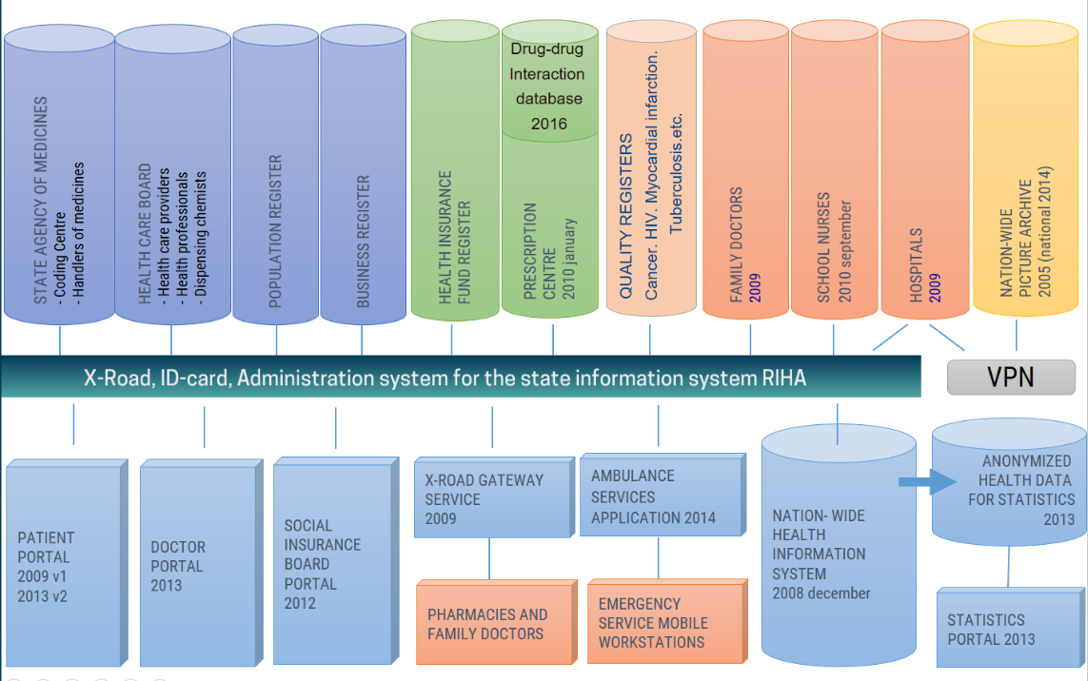

Slide 11
Thank you!

