Slide 1



eBooking in Estonia

Slide 2

People forget to cancel booking
Separated booking systems for each hospital
Long waiting queues
Due to lack of financial resources – eBooking does not solve this
Due to lack of free timeslots – eBooking may help to solve this
Patients must either call, e-mail or use different hospital systems one-by-one
MAIN PROBLEMS
SOLUTION SOLVE
Average time wasted to find available time for visit was estimated to be around 1 hour
Complicated change or cancelling of booking
Cancelling booking could lead to not finding the new time at all
Multiple bookings for one service in different hospitals

Slide 3








UNTIL 2019
Calling or e-mailing
to different hospital solutions
1 REFERRAL= Possibly multiple bookings
Time-consuming and annoying
Easy to forget to Cancel
multiple responses
TODAY
1 request for
available times
SINGLE ACCESS POINT
for all integrated hospitals
1 REFERRAL=1 BOOKING
DIRECT PAYMENT
Easy to change or cancel

Slide 4
Roadmap for eBooking
eBooking Launch in 2019
Feedback updates – continuous development
32 service providers until December 2019
73 service providers until August 2020
279 service providers until January 2023
Functional prototyping and agreeing with all partners
Service Providers, patients, general practitioners, authorities, standards development
Paradigma change from medical speciality to medical services
2015
2016
2017
2018
2019
Digital referrals 100% implementation 2016-2018
Funding and procurement
Development
Within 8 months

Slide 5








How does it work ...
All communication via X-Road

Slide 6





What we
ACHIEVED
Patients
Service Providers
  279 service providers currently, including many family doctors
  369 diferent services
Single Access-Point for patients
  to all hospitals and family doctors
  to referrals and bookings
Booking for family members and represented persons
Easy to change/cancel booking
Direct payment via BankLink
eBOOKING
No changes in internal processes, old channels still work
Less „empty“ visits
Additional channel for patients
Direct payment via BankLink
No need to develop and maintain local eBooking system
Less reporting to authorities (it’s automatic now)
Lower investment and running costs
Analysis and statistics
Queue analytics enabling better resource management
On-line reporting services for
  Public
  State
  Service Providers
State

Slide 7

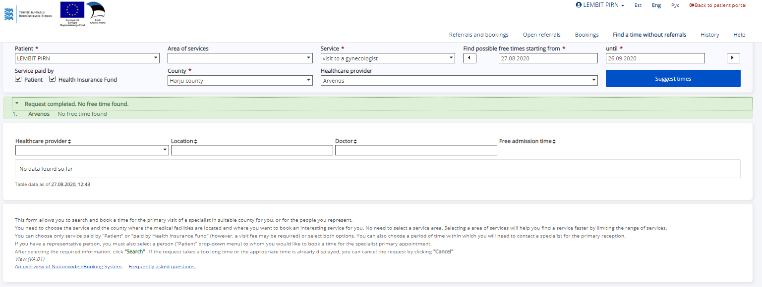
Free time search + suggestions

Slide 8
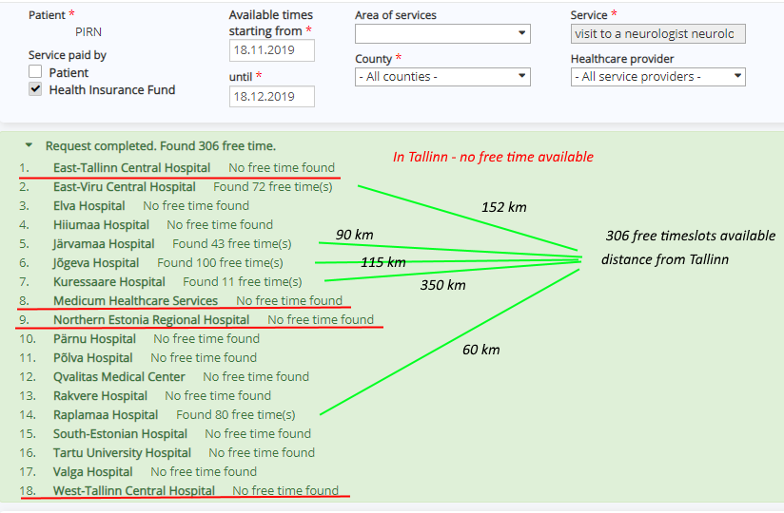
Patient mobility

Slide 9
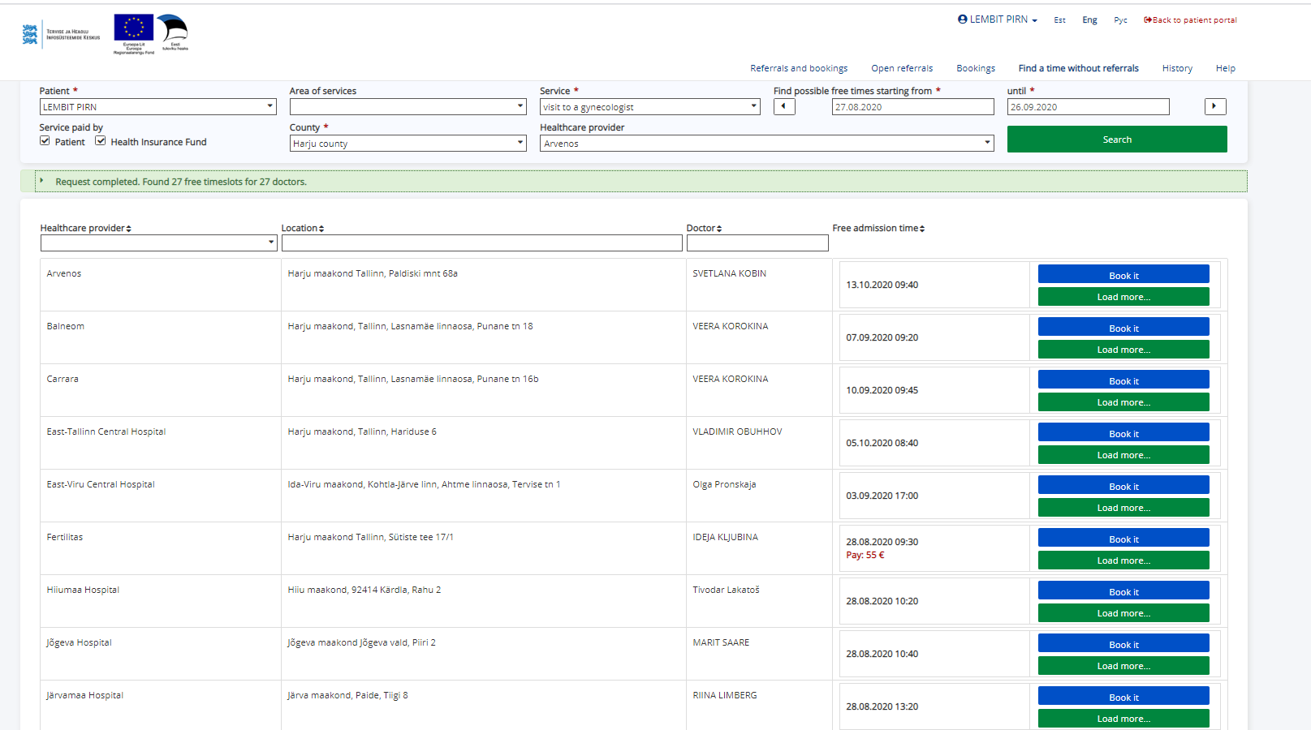
Suggestions

Slide 10
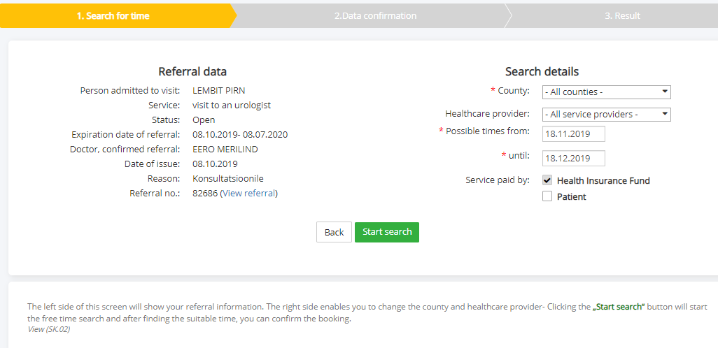
Free time search with referrals

Slide 11
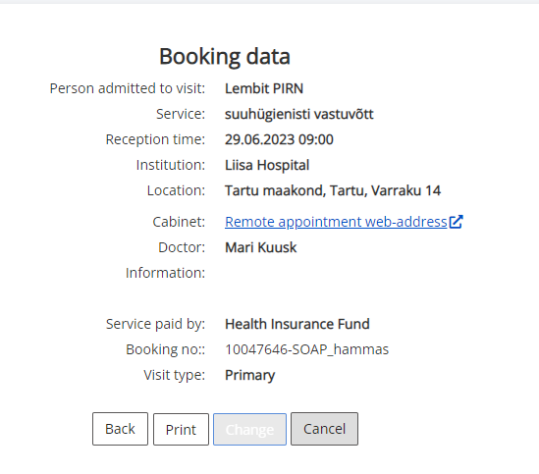
Remote visits

Slide 12
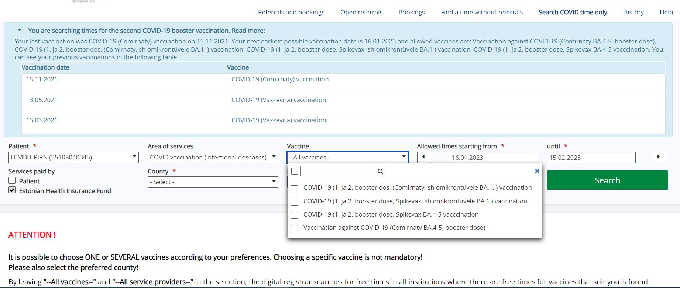
COVID-19 vaccination

Slide 13
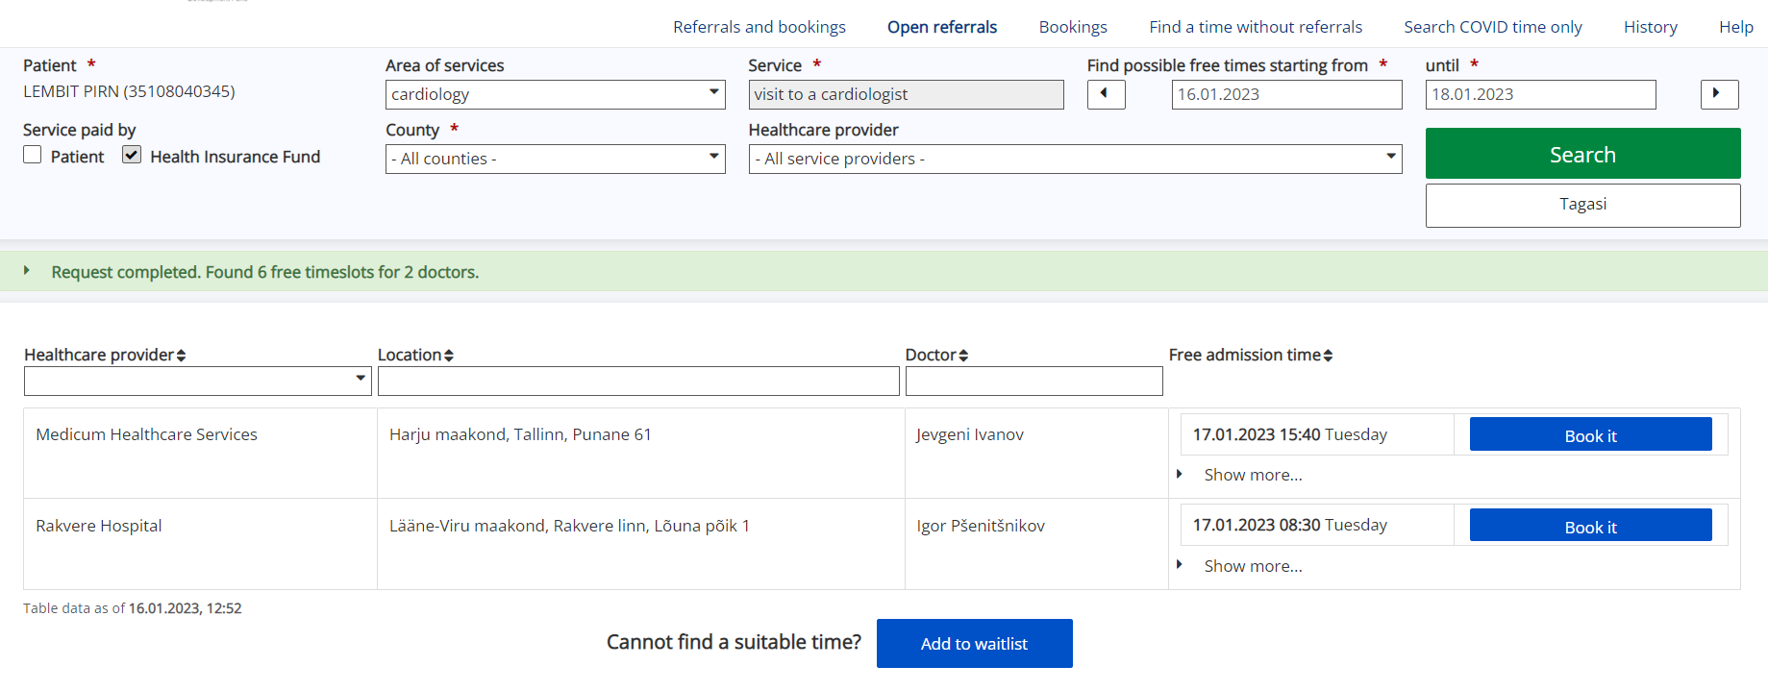
Waiting lists

Slide 14
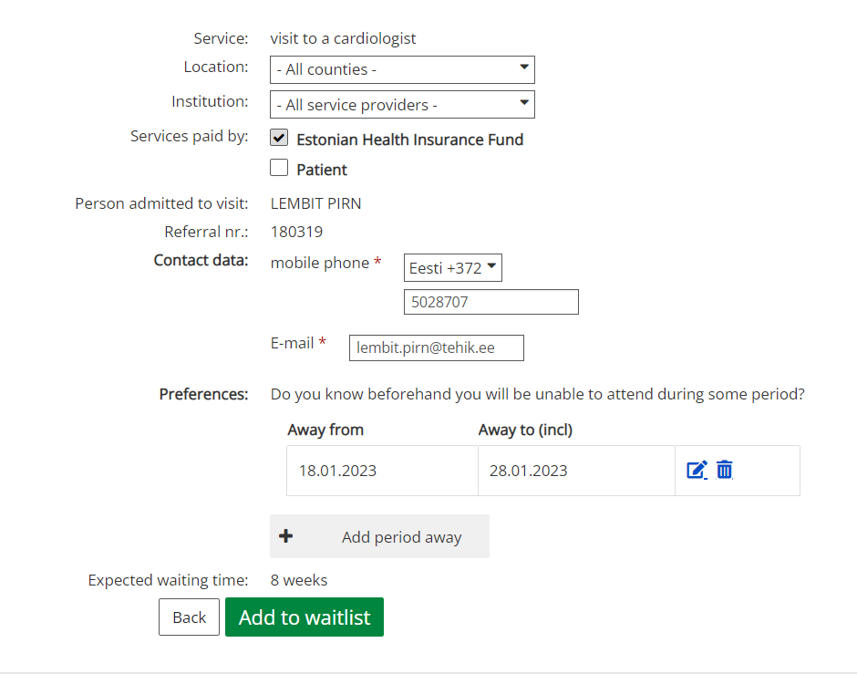
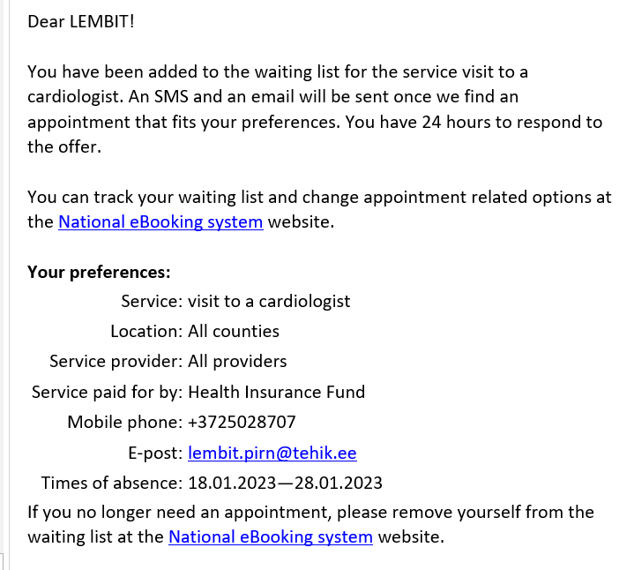
Waiting list management

Slide 15
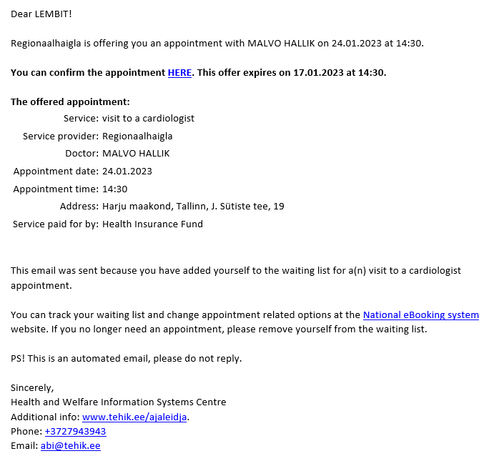
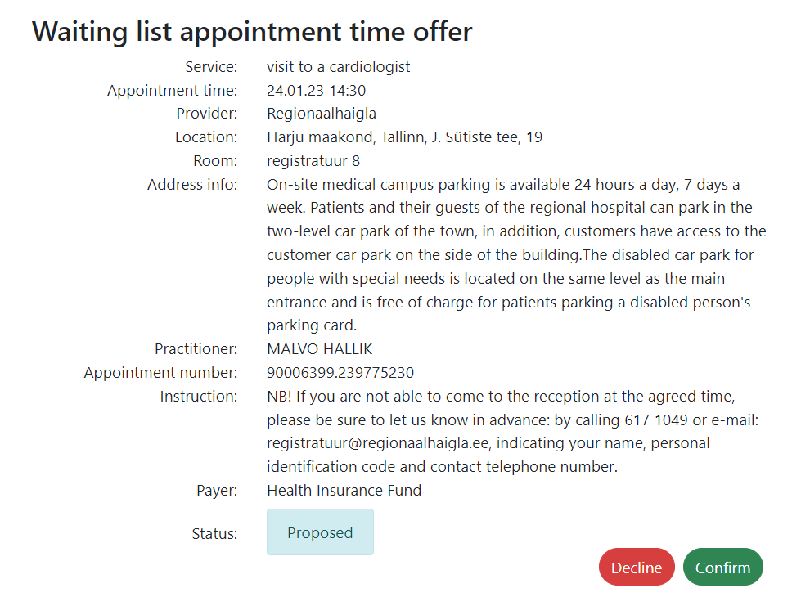
Waiting list offering

Slide 16
What we learned
Society-wide agreements are very important
Patient approvals
Service providers (SP) should support and agree in solution
There should be some benefit for SP
      Market apperiance
            Financial aspects
            No additional development costs
Statistics
  Better understanding of queues and availabilities.
  Waiting time analysis based on real data.

Slide 17

Next developments
Booking for hospital care and care homes
Booking for studies
Waiting queue mechanisms for
        Specialty services care
    Hospital care and care homes
    Surgery queue management
    Resource mangement

Slide 18
Thank you!

